Slide 1
Capstone Project 2
Seoul Bike Sharing Demand Prediction
Kiran Ahire

Slide 2
Points for Discussion
Business Objective
Data Summary
Feature Summary
Data Preprocessing
Exploratory Data Analysis
Corelation between data
Algorithms implementation
Conclusion

Slide 3
Business Objective
Currently Rental bikes are introduced in many urban cities for the enhancement of mobility comfort. The client is Seoul Bike, which participates in bike share program in Seoul, South Korea. An accurate prediction of bike count is critical to the success of Seoul Bike share program. It is important to make rental bike available and accessible to the public at right time as it lessens the waiting time.
Rented bikes are mostly used by the people having no personal vehicles or those people who wants to avoid congested public transport. Eventually providing a city with stable supply of motor bikes become a major concern.
The goal of the project is to predict number of rental bikes required at each hour for stable supply of rental bikes.

Slide 4
Data Summary
This dataset contains 8760 rows and 14 columns.
Three categorical features “Seasons ”,”Holiday” and “Functioning Day”
One datetime feature “Date”
Following columns are of numerical data
1. Temperature
2. Humidity
3. Wind speed
4. Visibility
5. Dew point Temperature
6. Rainfall
7. Solar radiation
8. Snowfall

Slide 5
Feature Summary
Date : year-month-day
Rented Bike count - Count of bikes rented at each hour
Hour - Hour of he day
Temperature-Temperature in Celsius
Humidity - %
Windspeed - m/s
Visibility - 10m
Dew point temperature - Celsius
Solar radiation - MJ/m2
Rainfall - mm
Snowfall - cm
Seasons - Winter, Spring, Summer, Autumn
Holiday - Holiday/No holiday
Functional Day - NoFunc(Non Functional Hours), Fun(Functional hours)

Slide 6
Data Preprocessing
There are no missing values present
There are no duplicate values present
There are no null values present
‘Rented bike count’ is the dependent variable which we need to predict for our new observations
The dataset is hourly rental data for one year so that I converted ‘Date’ feature into new features namely ‘Day’ , ‘Month’ , ‘Year’
In our dataset"Hour","month","weekdays_weekend" column are integer data type but it should be category data type. so I change their data type.
I rename some of the features for convenience.

Slide 7
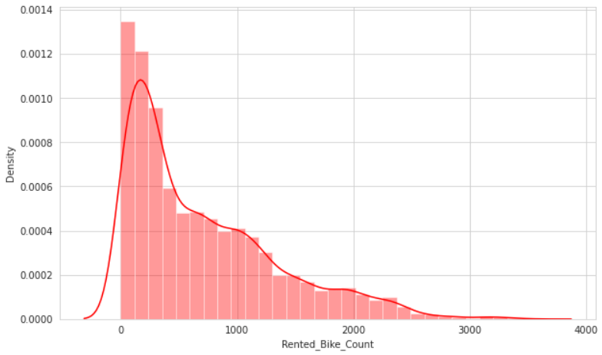
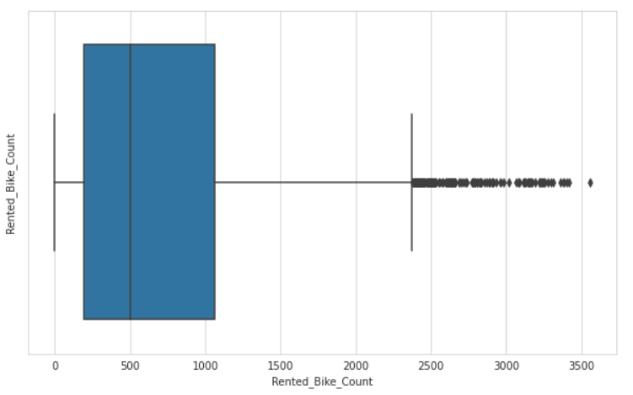
Analysis of Rented Bike count
The above graph shows that Rented Bike Count has moderate right skewness.
The above boxplot has detected outliers in Rented_Bike_Count
Since the assumption of linear regression is that 'the distribution of dependent variable has to be normal', so we should perform some operation to make it normal. To reduce the right skewness we will apply Square root method.

Slide 8
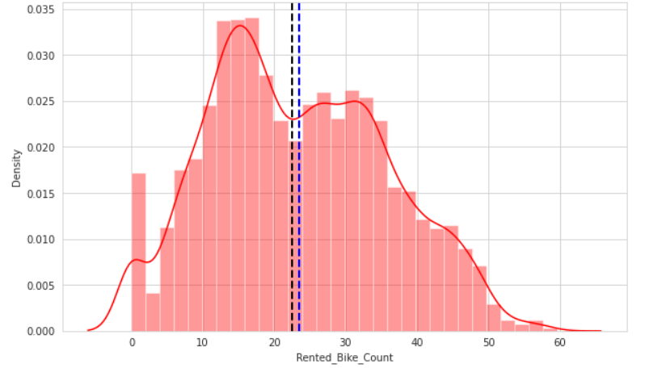
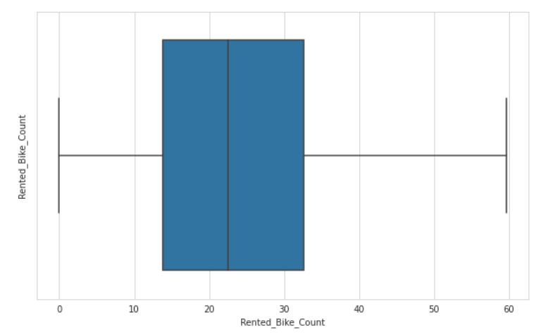
Analysis of Rented Bike count
From the above plot we can say that after applying Square Root method, Rented_Bike_Count column now is in Normal Distribution.
After applying Square root to the Rented Bike Count column, we find that there is no outliers present.

Slide 9
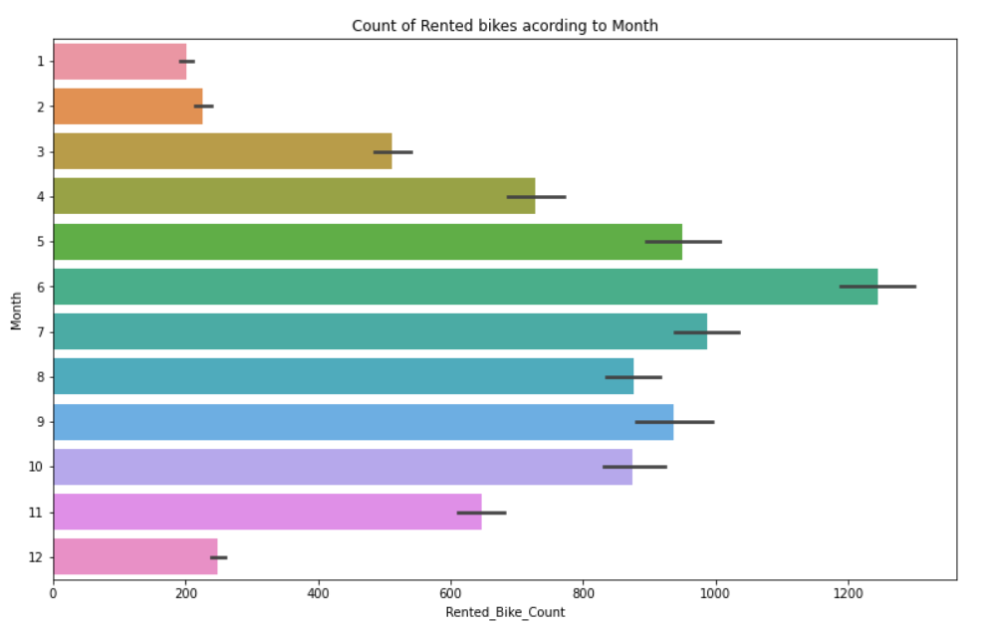
Analysis of Month
From the above graph we can say that from the month 5 to 10 the demand of the rented bike is high as compare to other months. These months fall in the summer season.

Slide 10
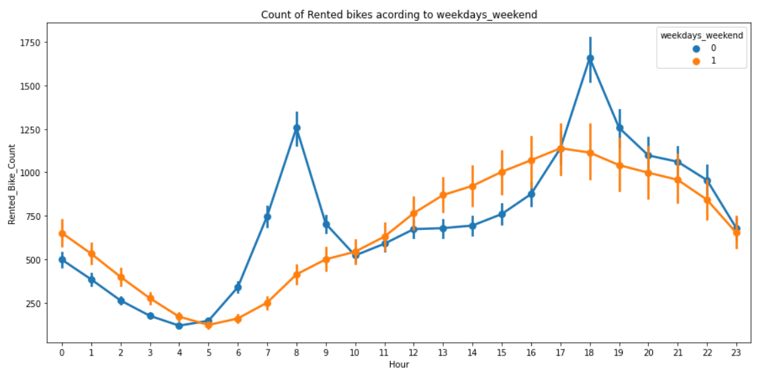
Analysis of weekdays_weekend
From the above point plot and bar plot we conclude that in the week days which represent in blue color show that the demand of the bike higher during 7am to 9am and 5pm to 7pm.
The orange color represent the weekend days, and it show that the demand of rented bikes are very low specially in the morning hour.

Slide 11
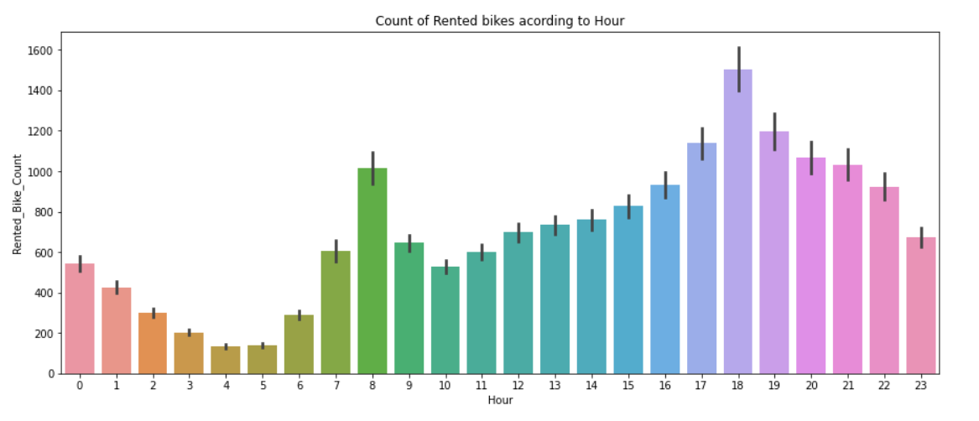
Analysis of Hour
The above plot shows the use of rented bike according the hours.
From the above plot we conclude that people generally use rented bikes during working hours from 7am to 9am and 5pm to 7pm

Slide 12
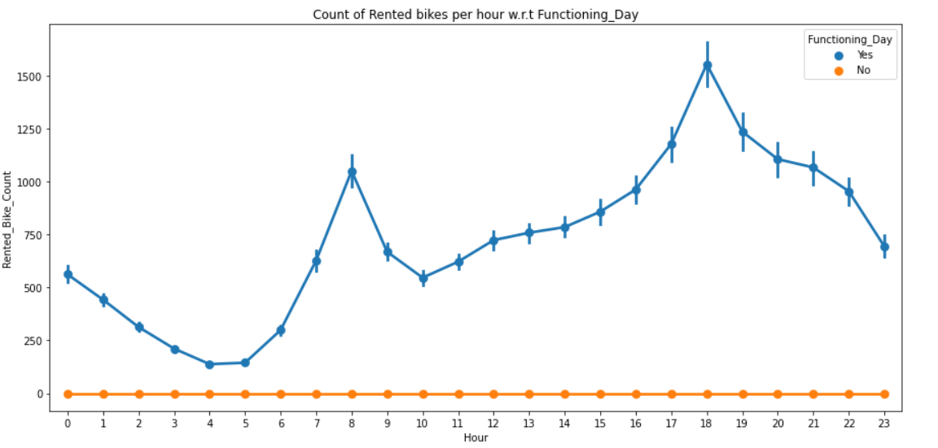
Analysis of Functioning_Day
From the above point plot we can conclude that people do not use rented bike on no functional day.

Slide 13
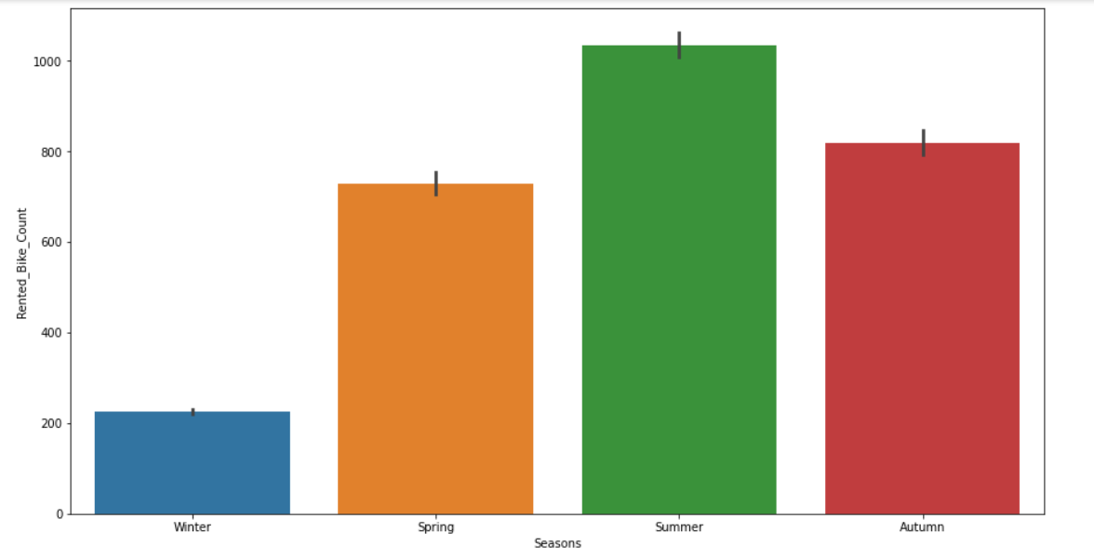
Analysis of Season
The above bar plot shows the distribution of rented bike count season wise.
From the above graph we can say that people love to ride bikes in Summer season followed by Autumn.
People avoid riding bikes in winter season.

Slide 14
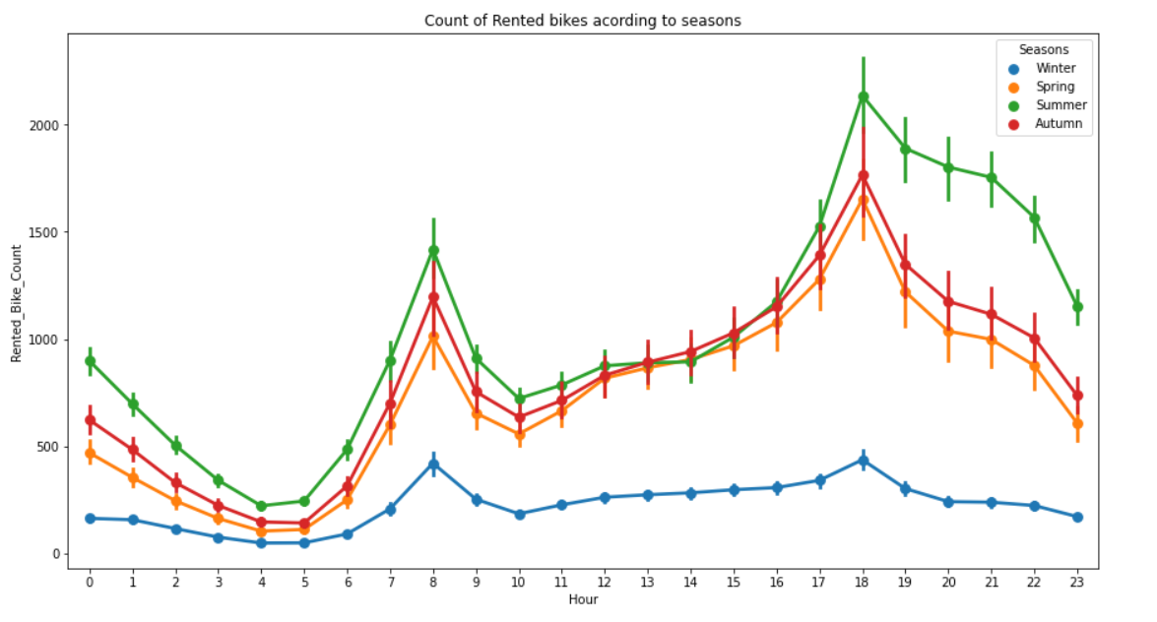
Analysis of Season
The above graph shows the use of rented bike in different seasons, from the above graph we can say that in summer season the use of rented bike is high and peak time is 7am-9am and 7pm-5pm.
In winter season the use of rented bike is very low because of snowfall.

Slide 15
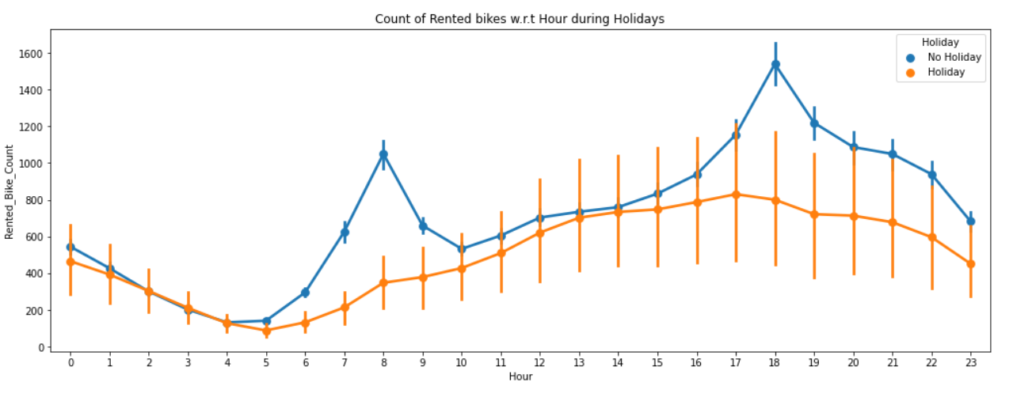
Analysis of Holiday
The above plot shows the use of Rented bikes during holidays and from above plots we can say that people generally use rented bikes between 2pm to 8pm on holidays.

Slide 16
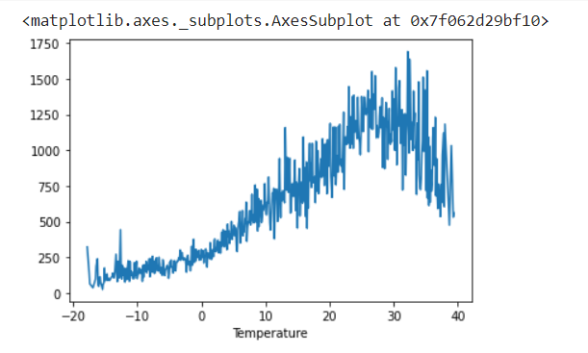
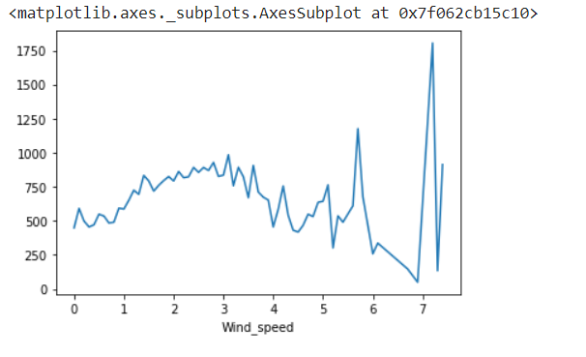
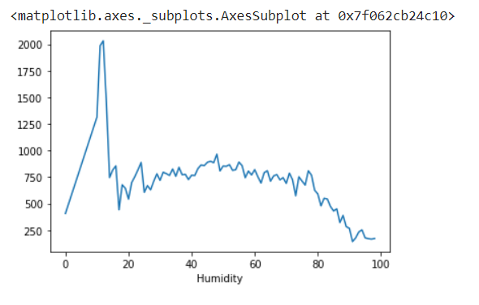
Numerical vs Rented_Bike_Count
From above graph we conclude that people like to ride bikes when the temperature is around 25°C
From above plot we can say that Wind_speed is uniformely distributed but when Wind_speed is around 7 m/s demand for bikes is higher so we can say that people likes to ride bikes when its little windy.
From the above graph we can say that demand for rented bikes is higher when humidity is around 10.

Slide 17
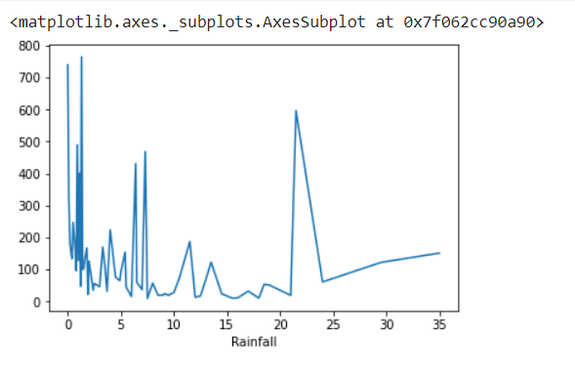
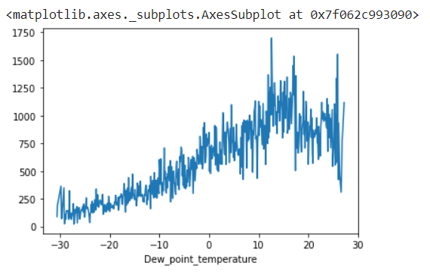
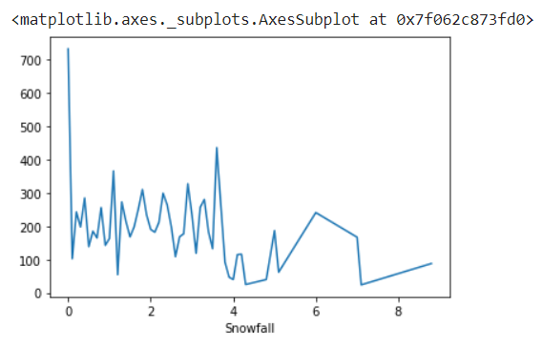
Numerical vs Rented_Bike_Count
We can see from the above plot that even if it rains a lot the demand of of rent bikes is not decreasing, here for example even if we have 20 mm of rain there is a big peak of rented bikes
From the above plot we can say that demand for rented bikes is high when Dew point temperature is between 10 to 20.
From this we can see when there was no snow then the demand is highest whereas when the snow is more than 4 cm then demand is decreasing.

Slide 18
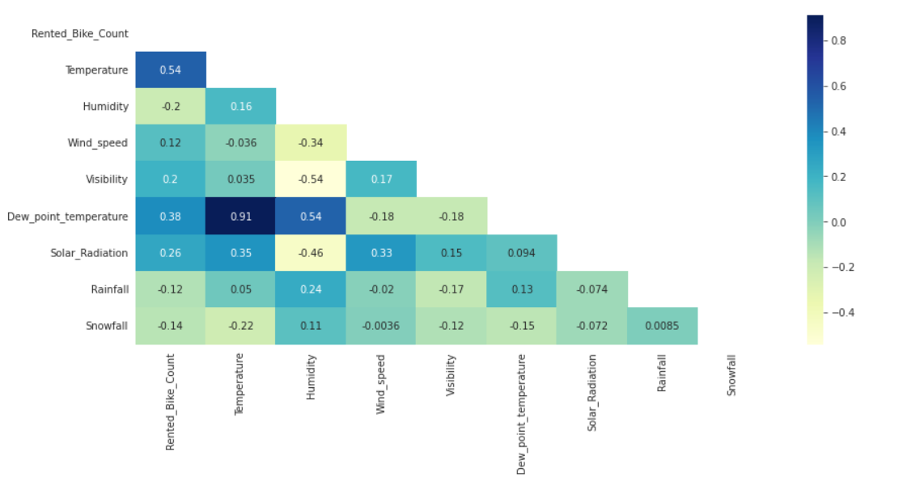
Corelation between variables
From the above Heatmap we can say that target variable Rented_Bike_Count is positively corelated with Tempreture , Dew_point_tempreture , Solar_Radiation
and negatively corelated with Rainfall , Snowfall.
From above graph we can say that columns 'Temperature' and 'Dew point temperature are highly corelated.

Slide 19
One Hot Encoding
Many machine learning algorithms cannot work with categorical data directly. The categories must be converted into numbers. This is required for both input and output variables that are categorical.
One hot encoding is one method of converting data to prepare it for an algorithm and get a better prediction.
With one-hot, we convert each categorical value into a new categorical column and assign a binary value of 1 or 0 to those columns. Each integer value is represented as a binary vector.
We have Categorical variables such as ‘Season’, ’Hour’, ’Month’ , ‘Holiday’
So we applied One Hot Encoding on them.

Slide 20
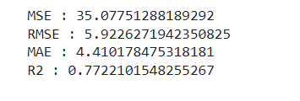
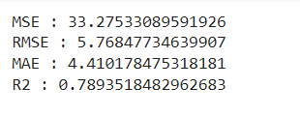
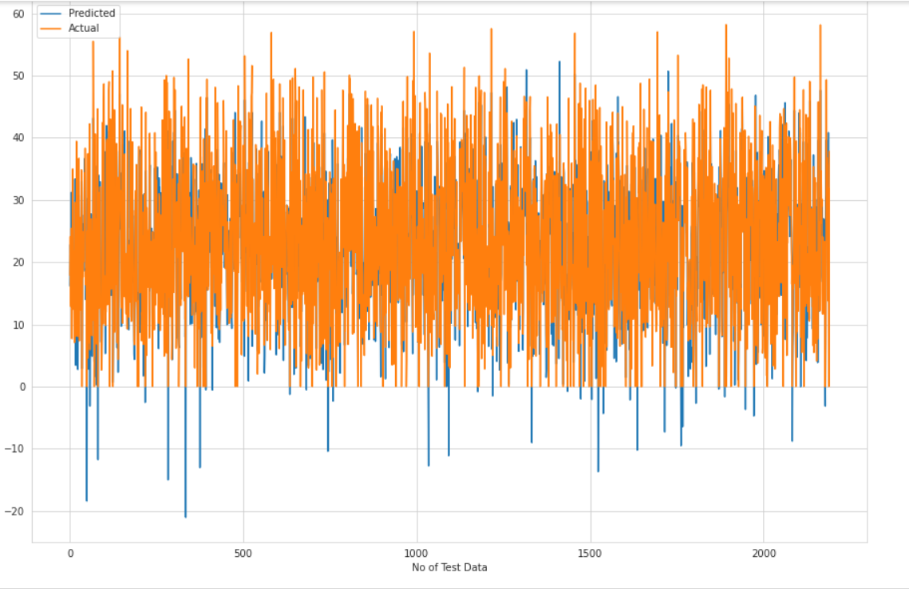
Models Implemented
Linear Regression
1. Linear Regression is a machine learning algorithm based on supervised learning
2. It performs a regression task
3. Regression models a target prediction value based on independent variables.
Train set results Test set results

Slide 21
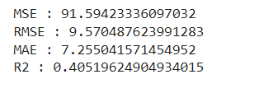
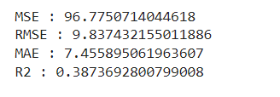
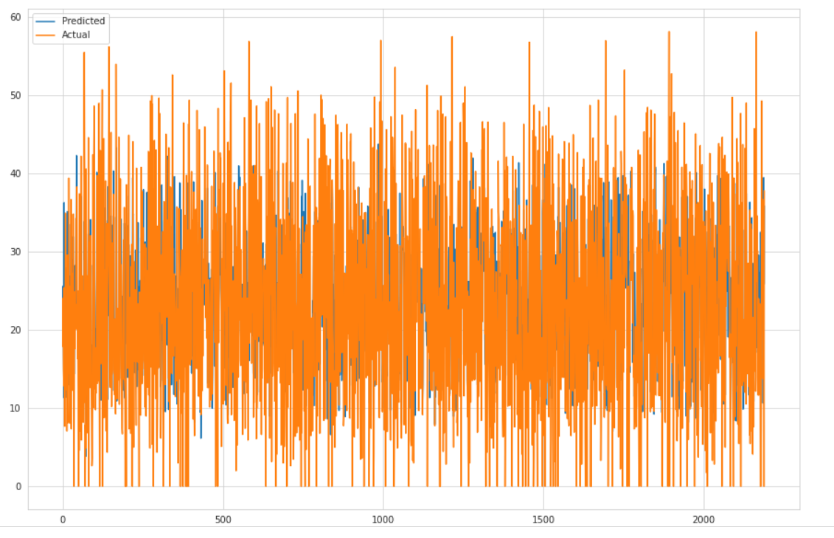
Models Implemented
Lasso Regression
Lasso Regression is an extension of linear regression that adds a regularization
penalty to the loss function during training.
Train set results Test set results

Slide 22
Conclusion
Rented_bike _count which is our dependent variable is mostly corelated with time of the day.
‘Hour’ is important feature in the dataset.
We observed that bike rental count is high during working days than non-working days.
We observed that people generally preferred bikes when it is moderate to high temperature and when its little windy too.
We can say that Rental bike count is high in Autumn and Summer season and low in Winter.
In Linear Regression R2 score value is 0.77 that means our model is able to capture most of the data variance.
In Lasso Regression R2 score value is 0.38 which is very poor as compared to Linear Regression so we can say LR is better model than Lasso.
Notes:
During the time of our analysis, we initially did EDA on all the features of our datset. We first analysed our dependent variable, 'Rented Bike Count' and also transformed it. Next we analysed categorical variable and dropped the variable who had majority of one class, we also analysed numerical variable, found out the correlation, distribution and their relationship with the dependent variable.
In Linear Regression R2 score value is 0.77 that means our model is able to capture most of the data variance.

